Slide 1

Predict Age, Gender and Ethnicity
Debsankar Mukhopadhyay
Vasim Shaikh
William Yerkes
Prabhanjan Trivedi
CS5542 – Big Data Analytics and Application - Project Presentation

Slide 2

Content
Introduction & related works – Debsankar M
Methodology – Vasim S
Experimental Results and Discussion – William Y
Conclusion – Prabhanjan T
Q & A
Journal Paper link - https://doi.org/10.1186/s40537-020-00358-x

Slide 3
Introduction
Provide the ability for companies to utilize their CCTV to capture images of their clients so as to be able to determine the demographics of their clientele so as to customize their marketing strategies to be able to be able to maximize the capital investment in targeted advertisement.
Utilize Artificial Neural Networks, (Convolutional Neural Network for this model) to analyze the images and determine the age, gender and ethnicity of the clientele
Create a single model that can determine all Three of the categories
Determine mood of person based on image (Happy, Sad, etc.)

Slide 4
Background
The structure of a CNN architecture is divided into multiple learning stages composed of convolutional layers, non-linear processing units, and subsampling layers
A typical CNN architecture is made up of alternate layers of convolution and pooling followed by one or more fully connected layers at the end. The CNN performance can be optimized by introducing mapping functions, batch normalization and dropout components. The pattern learning activities are aided by activation functions.

Slide 5
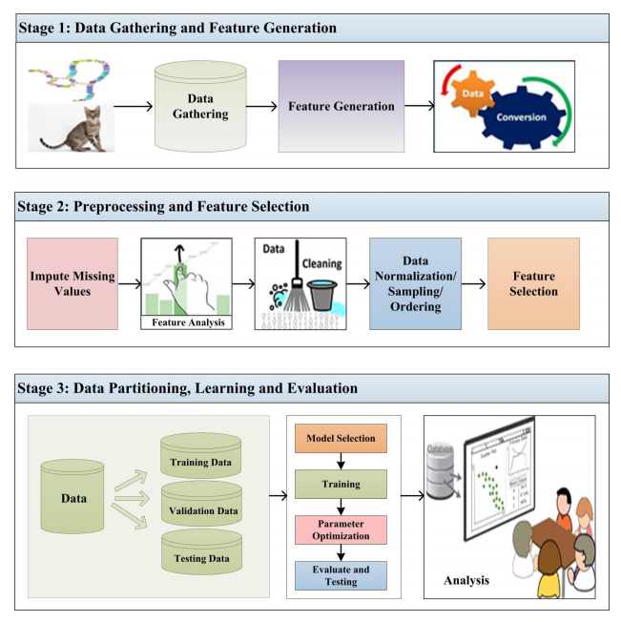
Background
Diagram of a Machine Learning (ML) system

Slide 6
Related Works
Age, Gender, and Ethnicity Determination
“Age estimation from faces using deep learning: A comparative analysis.” by : AliceOthmani, A. R. Talebb, H. Abdelkawya and A. Hadidc
“Joint gender, ethnicity and age estimation from 3D faces: An experimental illustration of their correlations.” by: B. Xia, B. B. Amor and M. Daoudi
“A hybrid deep learning CNN–ELM for age and gender classification.” by: M. Duan, K. Li, C. Yang and K. Li
“Effective training of convolutional neural networks for face-based gender and age predictio.” by: G. Antipov, M. Baccouche, S.-A. Berrani and J.-L. Dugelay
Mood Detection
“Facial expression recognition using optimized active regions” by: A. Sun, Y. Li, Y.-M. Huang, Q. Li and G. Lu

Slide 7
Architecture and Methodology
Research what others had done to solve the same problem and study their models.
Create and Experiment with various Models to determine what path to follow.
One model with 3 branches, one for age, ethnicity, and gender each.
Merge parameters into single parameter, creating single branch model.
We settled on One mode with 3 branches.
TBD

Slide 8
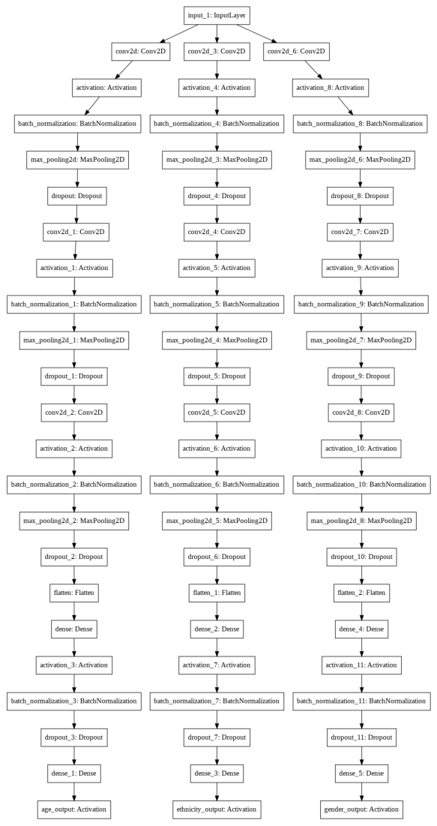
Unified Model

Slide 9
Data
23705 Facial Images
Image Size is 48 x 48 pixels
Classifications
Data is classified bases on three parameters:
Age, Ethnicity and Gender
Age has a range of 0 to 116
Ethnicity is broken down into 5 categories
Gender is classified as Male or Female
Data Distribution was not uniform

Slide 10
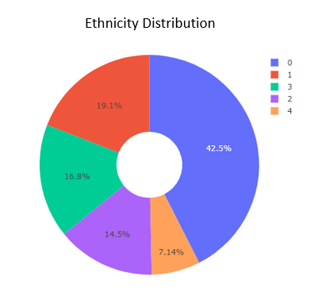
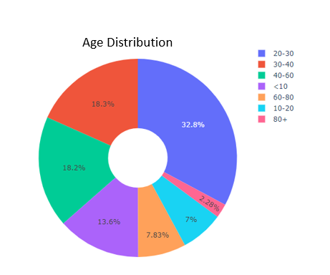
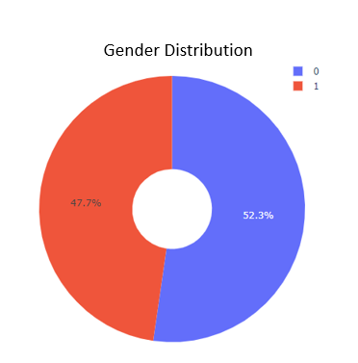
Data Distribution

Slide 11
Results
Race Accuracy of 76%
Category 0 ………………………..82%
Category 1 …………………….....81%
Category 2 …………………….....78%
Category 3 ………………………..69%
Category 4 …………………….....11%
Gender Accuracy of 89%
Male ………………………………...89 %
Female ……………………...……..88 %
Age Accuracy of 75%
Mean Absolute Error ………..7.3

Slide 12
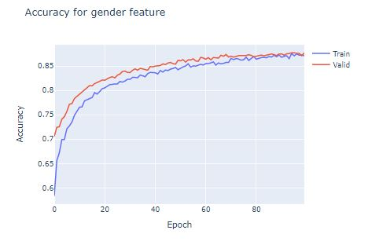
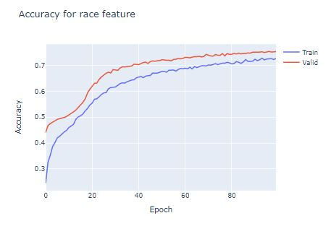
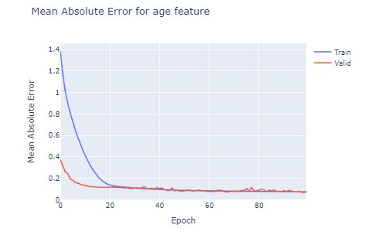
Results

Slide 13
Discussions

Slide 14
Conclusions

Slide 15
Future Outlook

Slide 16
Q & A

Slide 17
THANK YOU

